Slide 1
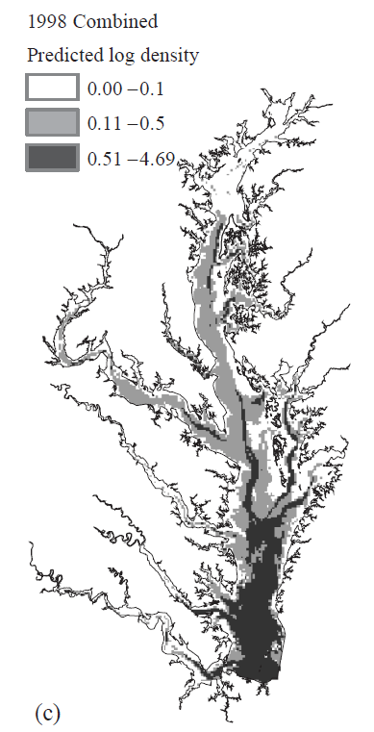
Jensen, et. al. 2005
Winter distribution of blue crab Callinectes sapidus in Chesapeake Bay: application and cross-validation of a two-stage generalized additive model

Slide 2
We present a 2-stage generalized additive model (GAM) of the distribution of mature female blue crab Callinectes sapidus in Chesapeake …The distribution and abundance of blue crabs was modeled …Depth, salinity, temperature, and distance from the Bay mouth were found to be the most important environmental determinants of mature female blue crab distributions. The response curves for these variables displayed patterns that are consistent with laboratory and field studies of blue crab/habitat relationships. The generality of the habitat models was assessed using intra- and inter-annual cross-validation. Although the models generally performed well in cross-validation, some years showed unique habitat relationships that were not well predicted by models from other years. Such variability may be overlooked in habitat suitability models derived from data collected over short time periods.

Slide 3
Sample Data
Non-commercial dredges
December to March
1989-1990
Sampling changed somewhat
1255-1599 stratified random stations
  3 regions
>15mm carapace

Slide 4
Predictors
Depth
Salinity
Water temp
Distance from Bay Mouth
Distance to submerged aquatic vegetation
Slope
Bottom type not available

Slide 5
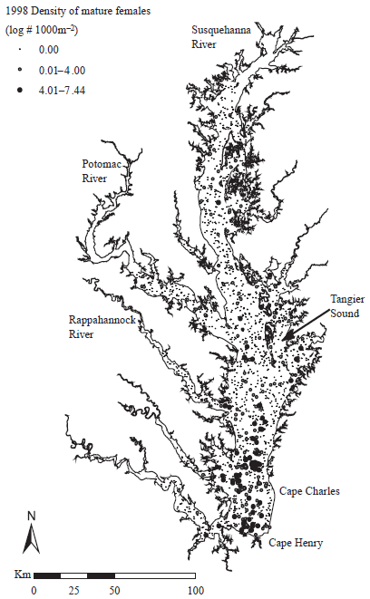
Blue Crab Distribution Model

Slide 6
Predictors
Bottom temp and salinity
  99 to 123 sites per year
  Kriging
Distance to Bay mouth
  Lowest-cost path from 250m raster map
Slope
  30 meter bathymetry

Slide 7



Modeling
75% training, 25% test
Stage I: presence of females
  Logistic: binomial error distribution, logit link
  D=depth, M=distance to mouth, V=distance to veg, S=salinity, B=bottom slope, T=temp
Stage II: female density sites >=1 crab
Abundance:

Slide 8
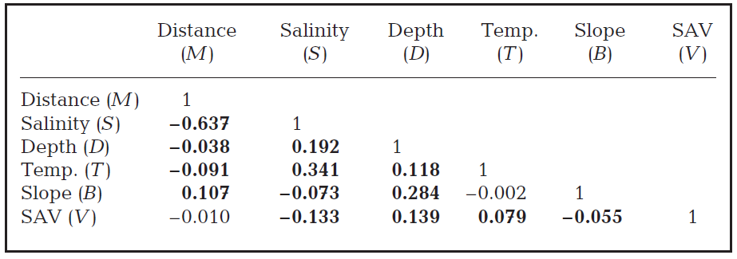
Predictor Correlation

Slide 9
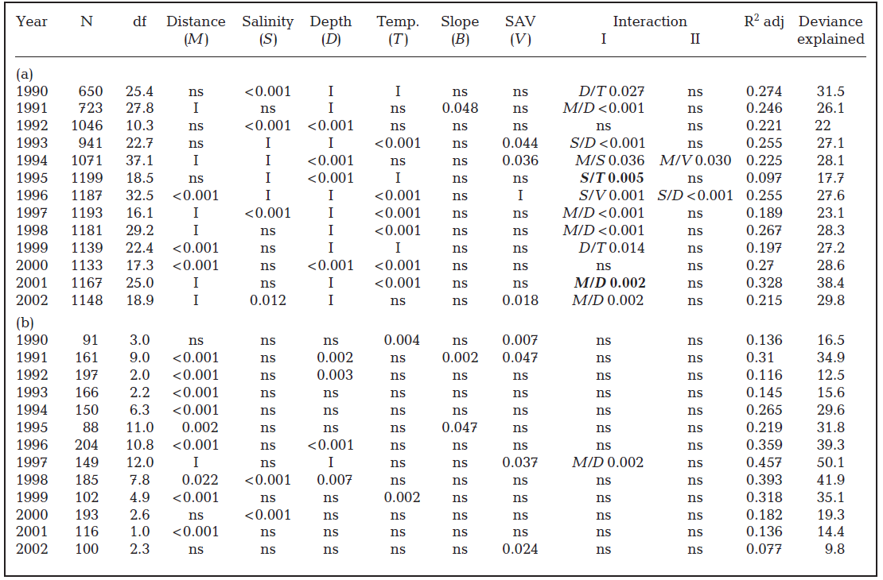
Notes:
Callinectes sapidus. Model selection results for (a) Stage I (presence/absence) and (b) Stage II (abundance) GAMs. Significance
test p-values are given for the explanatory variables distance from Bay mouth, salinity, depth, temperature, bottom
slope, distance from SAV, and interaction terms. Terms that were not significant (ns, p > 0.05) were dropped from the model
unless they were involved in a significant interaction (I). Degrees of freedom (df) were fixed for terms in bold. The adjusted
R2 and percent of deviance explained are also given for each model

Slide 10
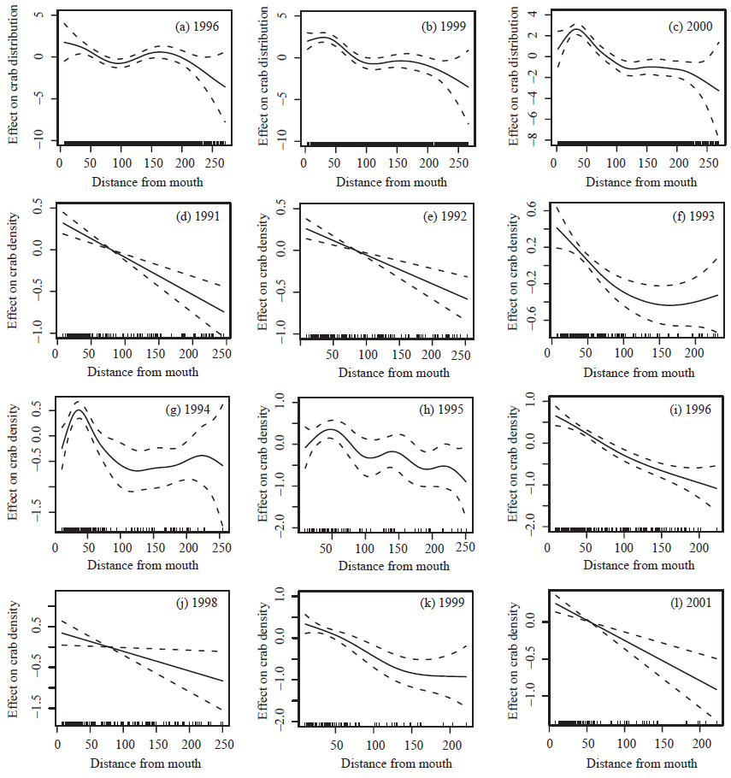
Distance
From
Mouth
Notes:
Fig. 2. Callinectes sapidus. Conditional regression spline smooths of distance from Bay mouth (km) on the probability of mature
female blue crab presence for (a) 1996, (b) 1999, and (c) 2000 and density (ind. 1000 m–2) given presence for (d–i) 1991 to 1996, (j)
1998, (k) 1999, and (l) 2001. Smooths are shown only for those years in which the variables were significant (p < 0.05) and not
included in an interaction term. The y-axis is the normalized effect of the variable; rugplot on the

Slide 11
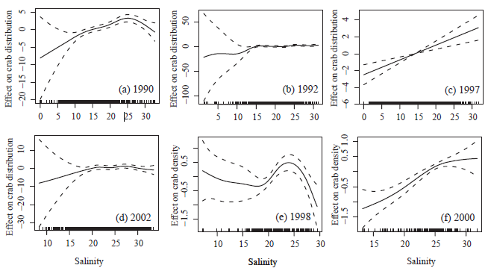
Blue Crab vs. Salinity
Jensen et. al. 2005, Winter distribution of blue crab Callinectes sapidus in Chesapeake Bay: application and cross-validation of a two-stage generalized additive model
Notes:
Fig. 3. Callinectes sapidus. Conditional regression spline smooths of salinity (ppt) on the probability of mature female blue crab
presence for (a) 1990, (b) 1992, (c) 1997, and (d) 2002 and density (ind. 1000 m–2) given presence for (e) 1998 and (f) 2000.
Smooths are shown only for those years in which the variables were significant (p < 0.05) and not included in an interaction
term. The y-axis is the normalized effect of the variable; rugplot on the x-axis represents the number of observations; dashed lines
are the ±2 standard error confidence belts

Slide 12
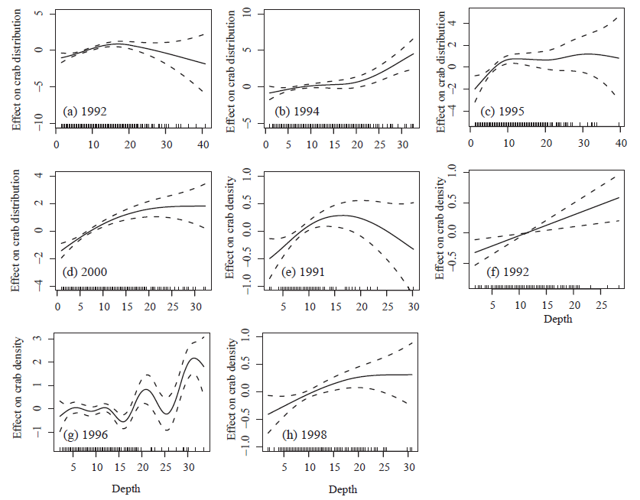
Depth

Slide 13
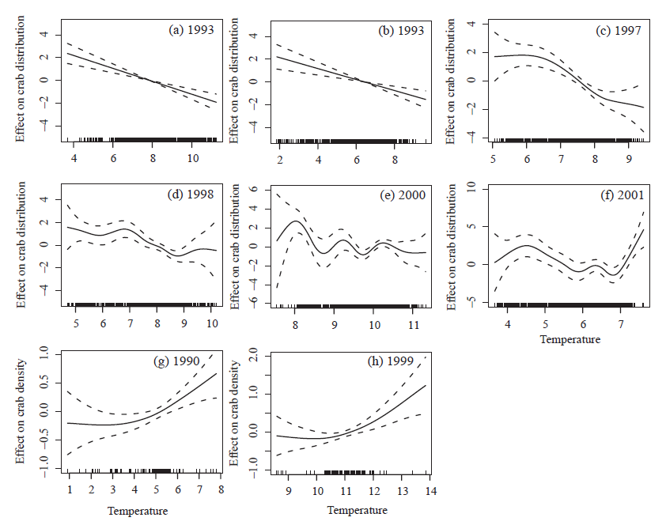
Temp

Slide 14
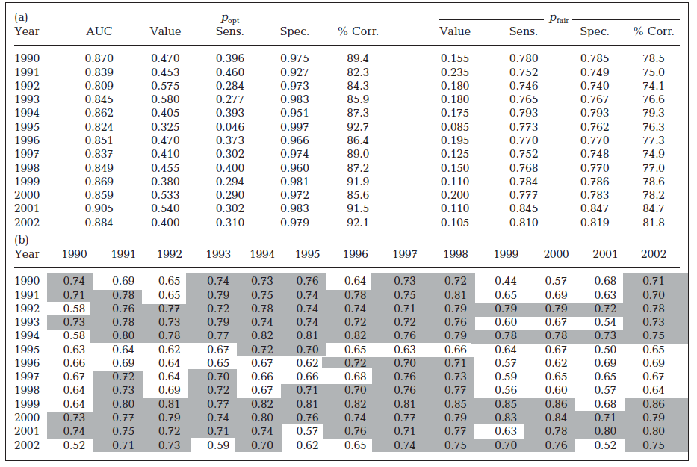
Skip this as we have not talked about AUC yet.
Notes:
Table 3. Callinectes sapidus. Evaluation of Stage I (presence/absence) model fits to the training data (a) using receiver operating
characteristic (ROC) curves and cross-validation of Stage I models (b). Values in (a) respresent the area unter the ROC curve
(AUC), the critical p-values: poptimum (popt) and pfair, and their sensitivity (sens.), specificity (Spec.), and percent correct predictions
(% Corr.). Values in (b) represent the AUC where models developed with data from one year (columns) are applied to data from
another (rows). Values on the diagonal represent intra-annual cross-validation where models developed using a training data
subset are applied to the test data subset for the same year. AUC values >0.7 are shaded

Slide 15
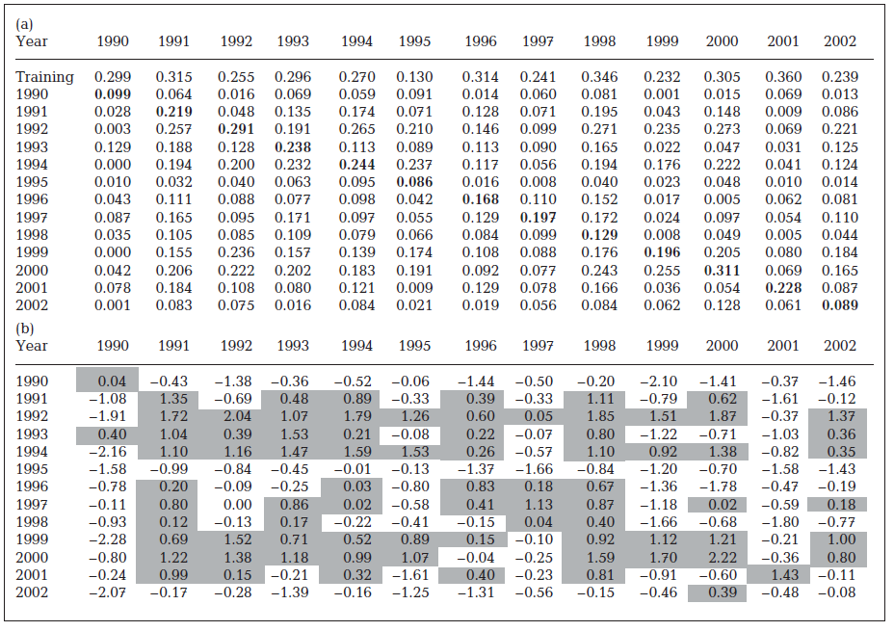
Notes:
Table 4. Callinectes sapidus. Cross-validation where models developed with data from one year (columns) are applied to data
from another (rows). Values in (a) respresent the cross-validation r-squared. Values on the diagonal (in bold) represent intraannual
cross-validation where models developed using a training data subset are applied to the test data subset for the same
year. The first row of (a) represents the model fit to the training data. Values in (b) represent the z-score, i.e. the number of
standard deviations above (shaded) or below the grand mean Fisher (1915) transformed cross-validation correlation coefficient

Slide 16
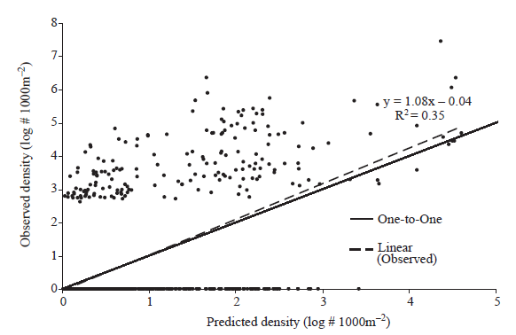
Fig. 6. Callinectes sapidus. Cross-validation plot showing observed vs. predicted log density (log # 1000m–2) for the 1998 training data, the one-to-one line (solid) and the linear regression line (dashed) fit to all data, including zeros. Note: multiple observations are overlaid along the x-axis near the origin
Notes:
Fig. 6. Fig. 6. Callinectes sapidus. Cross-validation plot showing observed vs.
predicted log density (log # 1000m–2) for the 1998 training data, the
one-to-one line (solid) and the linear regression line (dashed) fit to all data,
including zeros. Note: multiple observations are overlaid along the x-axis
near the origin

Slide 17
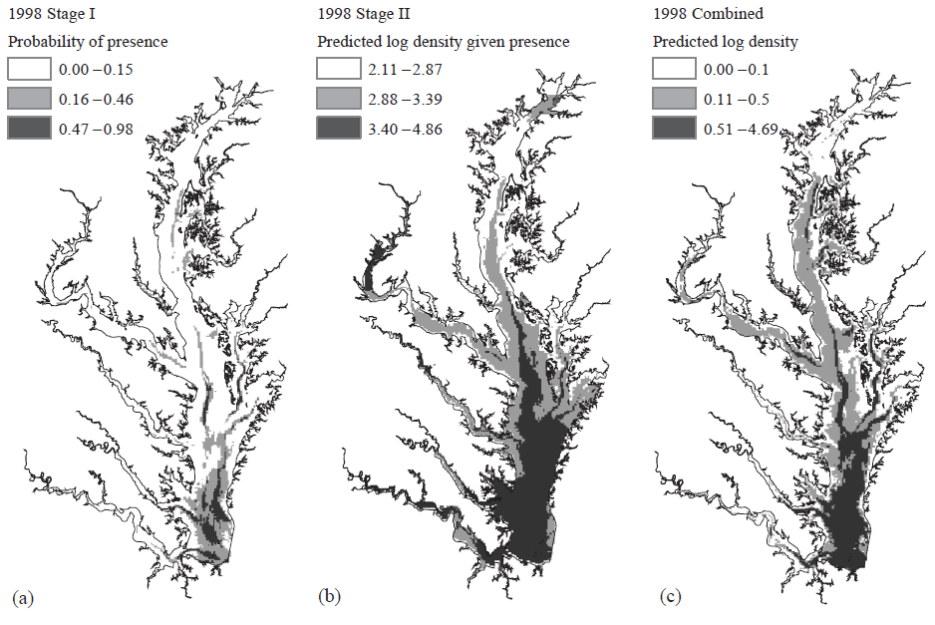

Slide 18
Additional Slides

Slide 19
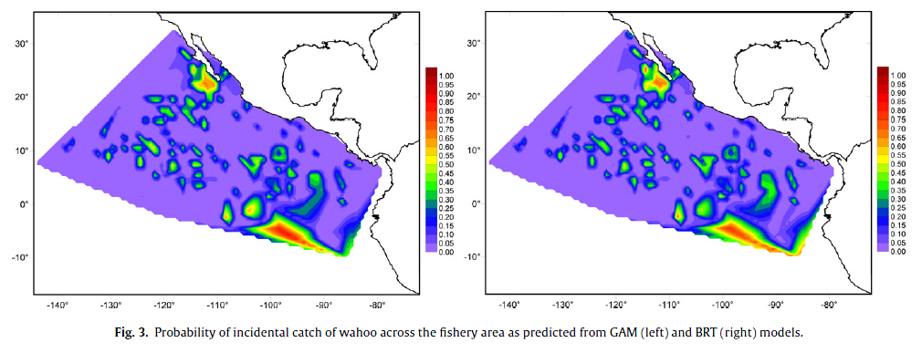
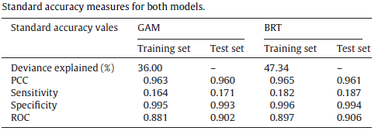
“Results indicate little difference between the performance of GAM and BRT models”
Best Possible Value
100%
1
1
0
1
Martinez-Rincon 2012, Comparative performance of generalized additive models and boosted regression trees for statistical modeling of incidental catch of wahoo (Acanthocybium solandri) in the Mexican tuna purse-seine fishery
Notes:
The BRT was made with over 5,000 trees!
deviance explained, percent correctly classified
(PCC), sensitivity (i.e., proportion of observed positives correctly
predicted), specificity (proportion of observed negatives correctly
predicted) and the area under the receiver operator characteristic
curve (ROC which gives a measure of the degree to which
fitted values discriminate between observed values)

Slide 20
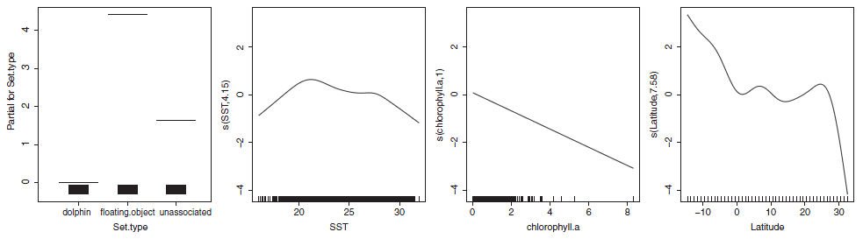
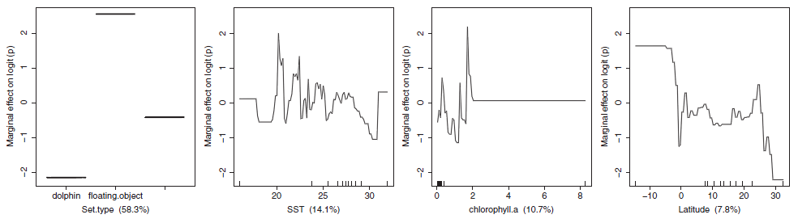
Response Curves (partial)
GAMs
BRTs

Slide 21
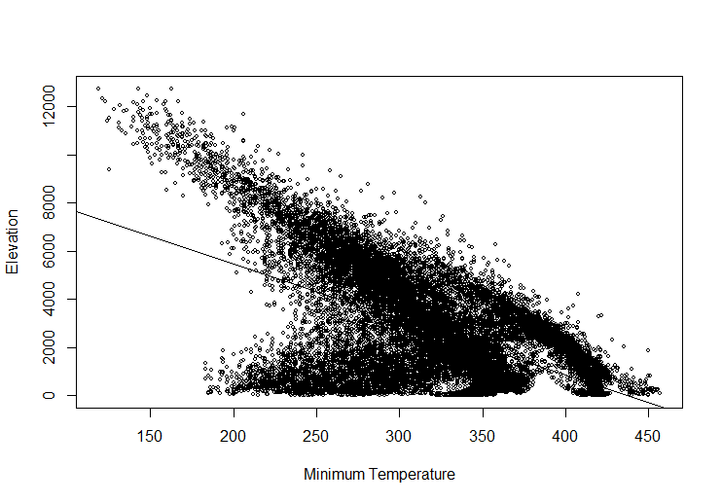

Slide 22
